Slide 1
ESP8266 + DS1820 + data.sparkfun.com
Vancouver Hackspace

Slide 2
Version: 1
Last updated: Feb 07, 2016 Slides and Example source code https://github.com/funvill/ESP8266Workshop
Social media
Vancouver Hackspace @VHS http://hackspace.ca Steven Smethurst (Funvill) @Funvill http://abluestar.com

Slide 3
What is included in the kit
ToDo: Insert photo of the kit

Slide 4

What is ESP8266?
Made by Espressif Systems
Integrated RISC processor
802.11bgn with Encryption
GPIO, SPI, UART, OneWire
Costs ~$3

Slide 5
What can I make with an ESP8266?
IsVHSOpen.com
IFTTT Internet button
Nest like thermostat
Remote camera trigger
Robots
and more…

Slide 6
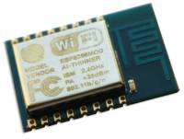
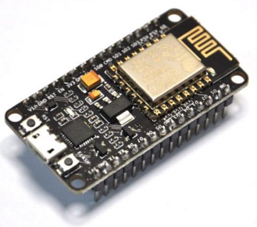
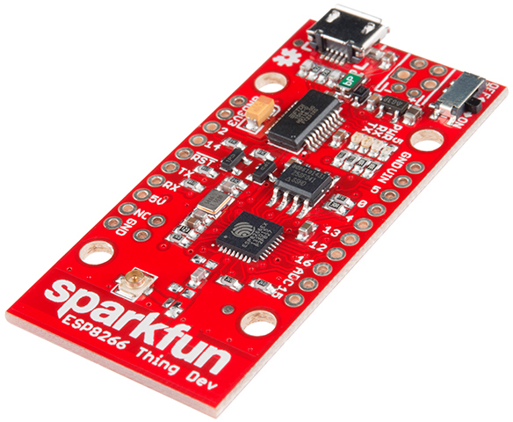
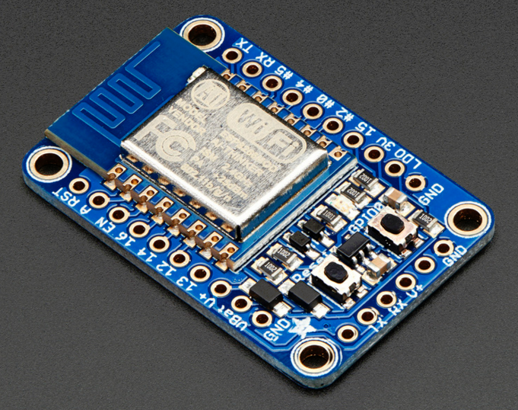
Comes in many shapes & sizes
ESP-12
NodeMCU
Sparkfun ESP8266 Thing
Adafruit HUZZAH

Slide 7
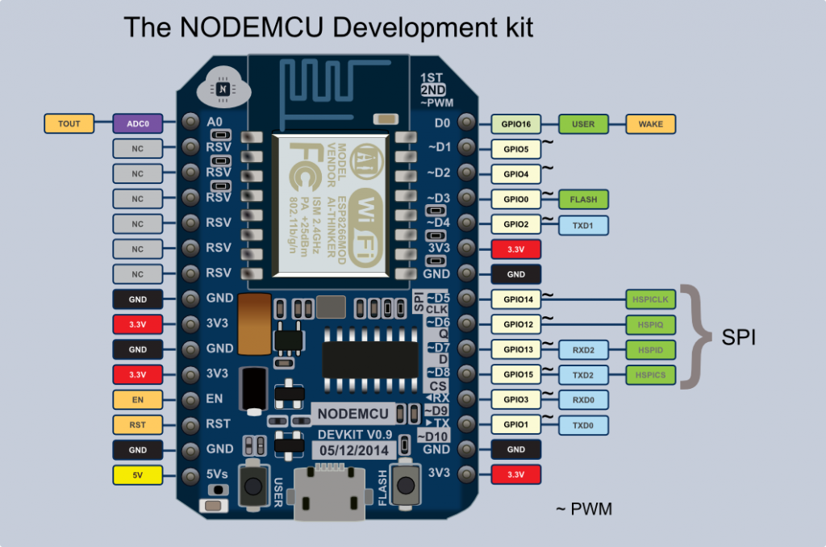
Anatomy of an NodeMCU, ESP8266 breakout board

Slide 8
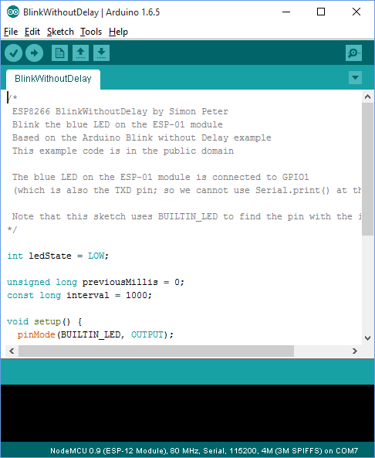
Download the Arduino IDE 1.6.5
Downloading and Install Arduino 1.6.5 from the Arduino website. Ensure that you download version 1.6.5, not the latest version. https://www.arduino.cc/en/Main/OldSoftwareReleases#previous

Slide 9
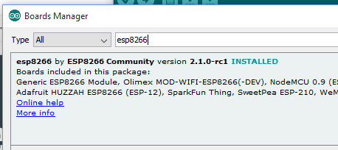
Update Arduino board manager
File ⇒ Preferences
Update “Addition Boards Managers URLs” to http://arduino.esp8266.com/stable/package_esp8266com_index.json
Tools ⇒ Board ⇒ Board manager
Search for “ESP8266” and install the new board.

Slide 10
If MAC OS then download these additional drivers
ToDo: Is this even necessary ?

Slide 11
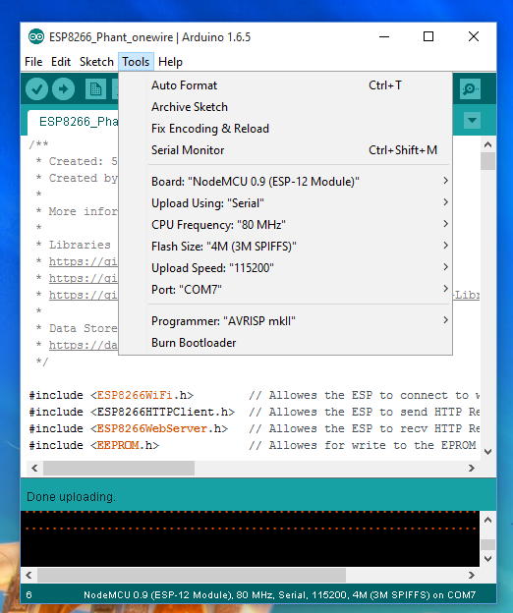
Connect to the board
Tools ⇒ Board ⇒ NodeMCU 0.9 (ESP-12 Module)
Select the right port for the board.
If the com port does not show up ensure that you have the device connected.
If your OS is Mac ensure that you have install the XXXX drivers.

Slide 12
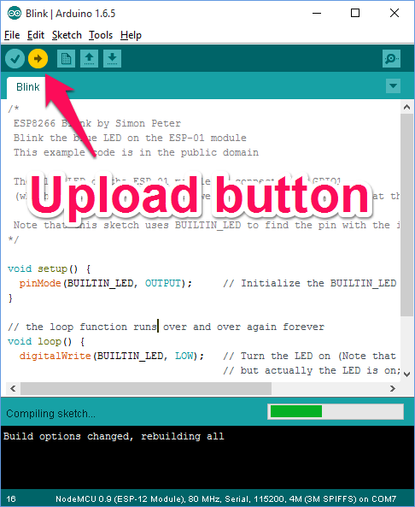
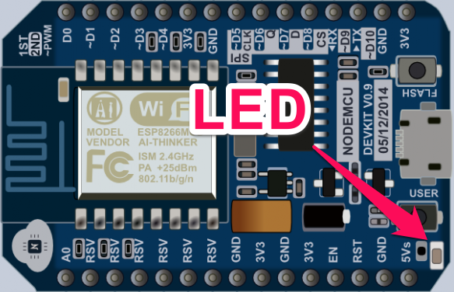
Load the Blink sketch
File ⇒ Examples ⇒ ESP8266 ⇒ Blink
Sketch ⇒ Upload or click the Upload button
The LED on the NodeMCU should start blinking

Slide 13
Install 3rd party libraries
WiFiManager:
Goto https://github.com/tzapu/WiFiManager and “Download Zip”
Sketch ⇒ Include library ⇒ Add .Zip Library…
Find and select the “WiFiManager-master.zip” archive
Arduino-Temperature-Control-Library
Goto https://github.com/milesburton/Arduino-Temperature-Control-Library and “Download Zip”
Sketch ⇒ Include library ⇒ Add .Zip Library…
Find and select the “Arduino-Temperature-Control-Library-master.zip” archive

Slide 14
Into to data.sparkfun.com
ToDo: Talk about what phant is.
Why we choose to use it for this course. Its free, its uses REST, it makes graphs, does not rely on libraries, You can export your data, self-hosting option, etc..
There are lots of other IoT data stores.
io.adafruit.com - Supports MQTT, free, lots of tutorials, in beta.
Xively - mature, developer-friendly but paid for real stuff.
Kinesis - Amazon, usual Amazon complexity, costs seem reasonable.
etc…

Slide 15
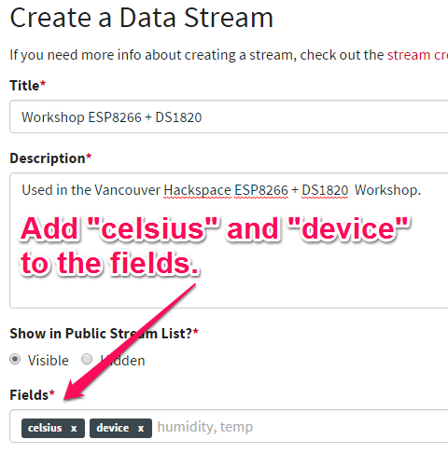
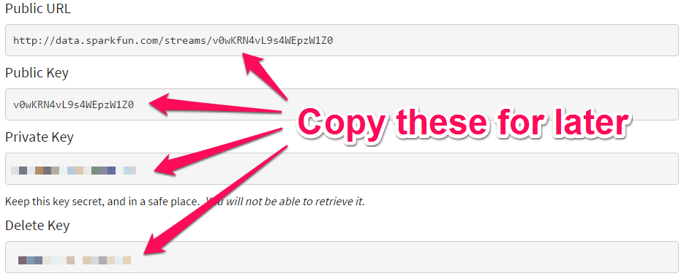
Create account on data.sparkfun.com
Goto http://data.sparkfun.com
Create a data stream
Add “celsius” and “device” to the “Fields”
Save the Public, Private and Delete keys.

Slide 16
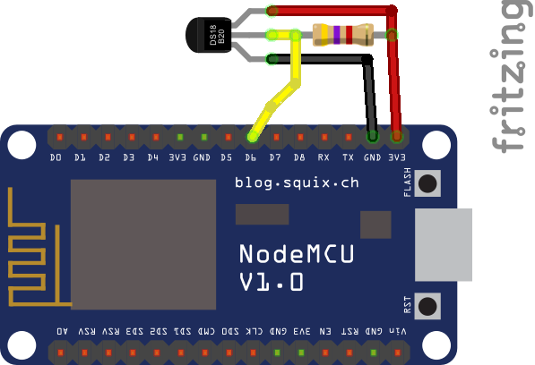
Wiring DS18B20 - One Wire Temperature sensor
ToDo: Add more info
GND to Black wire
3.3V to Red Wire
D6 (Data) to Yellow Wire
Resistor between Red (3.3v) and Yellow (Data) wire

